Slide 1
EE222 Lecture 7, January 26. 2019
Guidelines for Class Project
Shannon’s Theorem on Low Energy Limit on Binary Signaling
Power Analysis revisited
  Statistical simulation (e.g. CREST) vs. SPICE simulation
  Power Meter in SPICE-like simulation
  Use of Multiple Threshold Voltages (High Vth in noncritical paths; Low Threshold Voltages in Critical Paths)
  Leakage current vs. MOST Threshold Voltage
  Power Gating
  Threshold voltage dependence on backgate biasing in stacked transistors
Subthreshold Logic for Ultra-Low Power Operation

Slide 2
Class Project
A team of up top 2 students
Both written report and in-class PPT presentation are required
Each team presentation lasts 30 minutes
Final written reports are due on the day of final examination in liew of final examination
Each student will participate in evaluating others’ presentations
Topics should be related to low-power high-speed ICs- should be discussed with instructor before finalization
  Digestion, critique and ideas for improvement of published papers (included in the lecture materials, or other papers)
  Independent IC design and analysis for low power using CAD tools

Slide 3
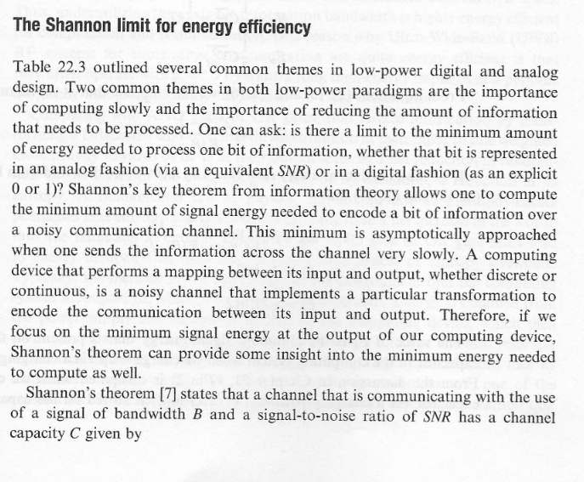
Fundamental Lower Limit of Energy Required for Signal Transfer
(Ref. Ultra Low Power Bioelectronics, Sect. 22.5)

Slide 4
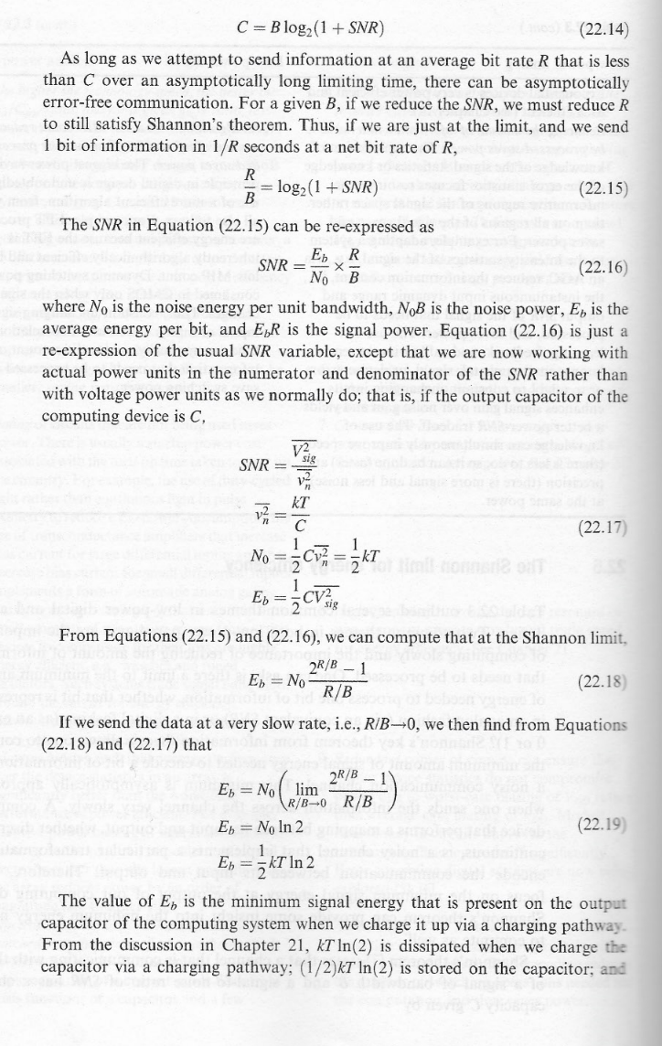
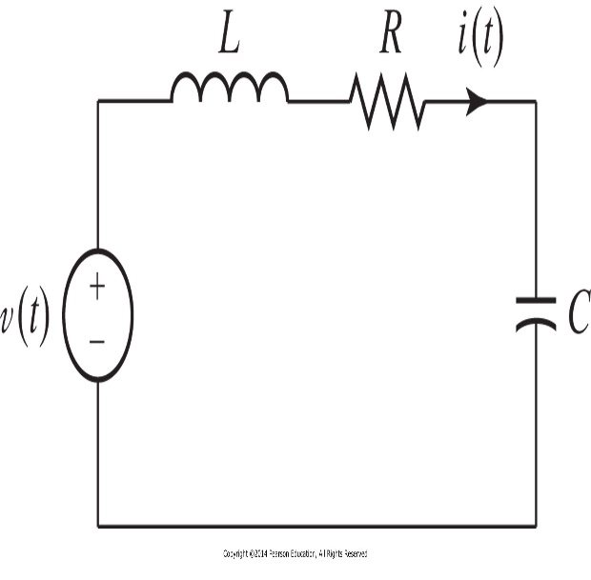
Signal is to be transferred from source v(t) to C (its voltage).
What is the minimum energy required to warrant
a significant SNR ?
Let C= channel Capacity
Let B= Bandwidth

Slide 6
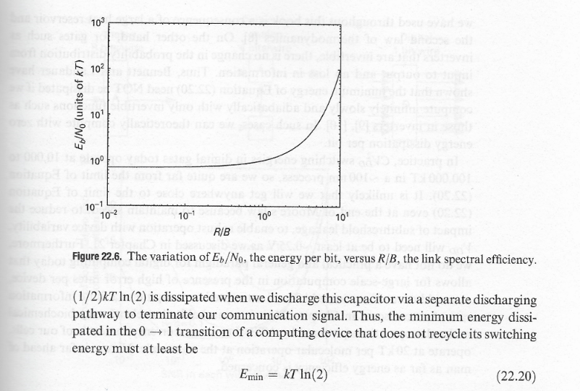

Slide 7
kT ln 2= (4.11E-21 J). Ln 2
= 17.81 meV
1 J= 27.78E-8 KWh = 1 mW.S
kT ln 2= 4.11E-21. 0.69. 1 mW.S= 17.81E-12 pW.S=17.81 pW.pS
For C=1 fF, CV**2= 1E-15 V**2= 17.81 pW.pS
which leads to V=sq root of (178.1E-10) = 13.3E-5
0.13 mV for T= 1 Sec, or
1.3V for T= 10 mSec

Slide 8

Shannon’s Theorem Revisited
C $≤B \log_{2}$ (1 + $\frac{P_{s}}{kTB}$ ) where $\frac{P_{s}}{kTB}$ $≪1$, and $P_{s}$= signal power
$\frac{C}{B} ≤ \log_{2}$ ( 1 + $\frac{P_{s}}{kTB}$ ) = $\frac{\text{ln}\text{ (1 + }\frac{P_{s}}{kTB}\text{ )}}{\ln{2}}$
$\ln{2} \frac{C}{B}$ $≤ \text{ln} \text{(}\text{1 + }\frac{P_{s}}{kTB}$ ) $≈ \sum_{n=0}^{∞}{\frac{{(−1)}^{n}}{n+1}}$ ${\text{(} \frac{P_{s}}{kTB})}^{n+1}$ $≈ \frac{P_{s}}{kTB}$
$\ln{2}$ kT $≤ \frac{P_{s}}{C}$ = $E_{BIT}$
Thus, $E_{BIT}$(min) = $\ln{2}$ kT

Slide 9
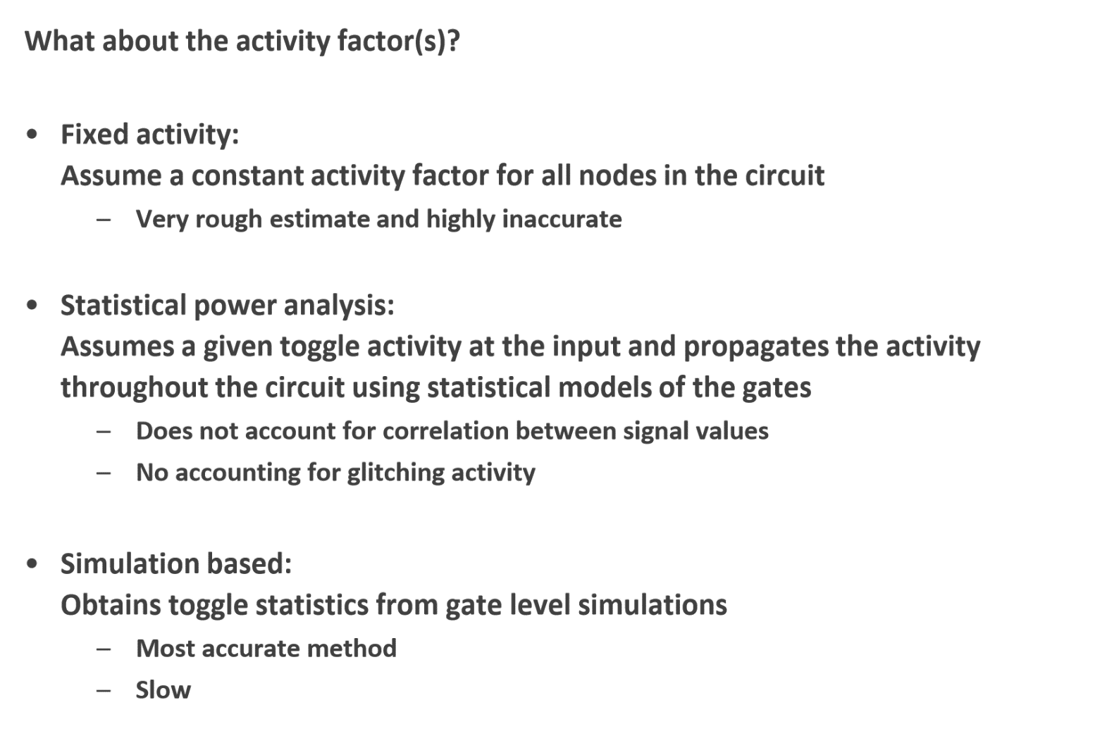
Power Analysis

Slide 10
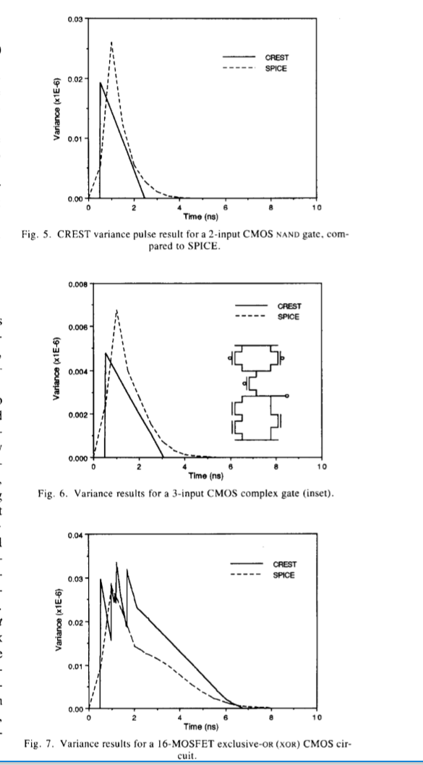
CREST vs. SPICE

Slide 11
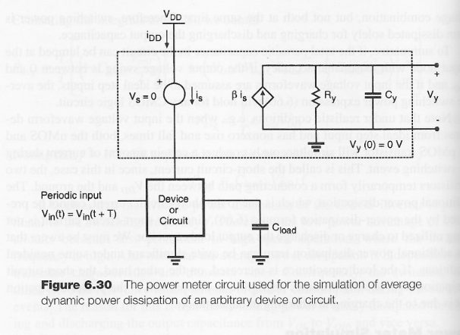
Power Meter ( Ref. S. M. Kang, “Accurate Simulation of Power Dissipation in VLSI Circuits,” IEEE J. of Solid-State Circuits, vol. SC-21, pp. 889-891, Oct. 1986)

Slide 12
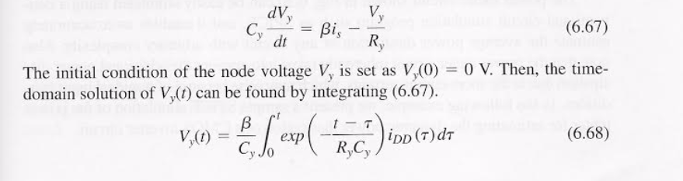
Solving for Vy(t)- a Power Meter Output
As long as Ry Cy>> (t - tau) and beta=Vdd Cy/T, then Vy(T)= Vdd.idd(average)= Average Power

Slide 13
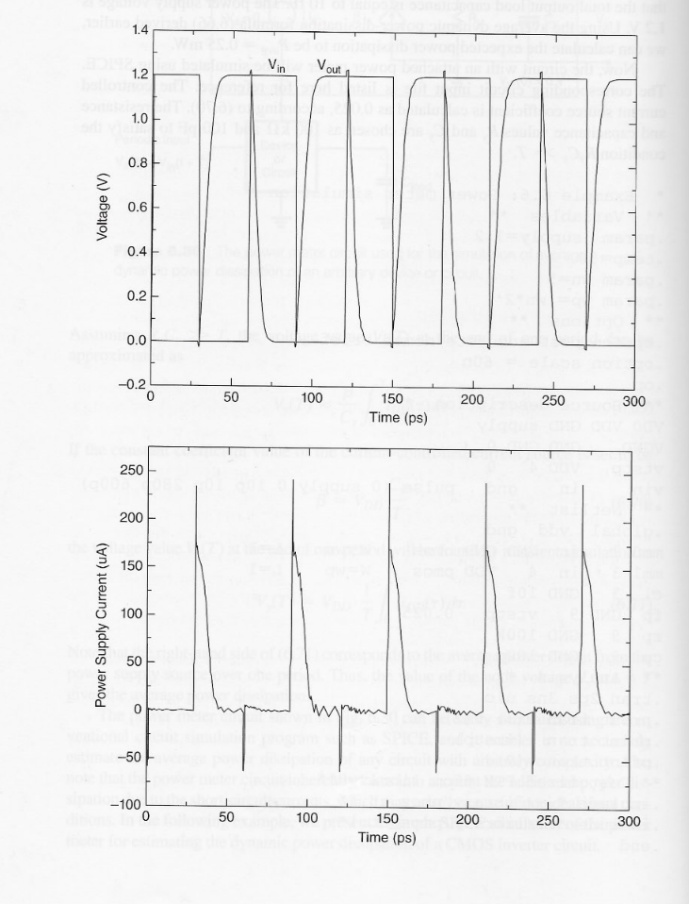

Slide 14
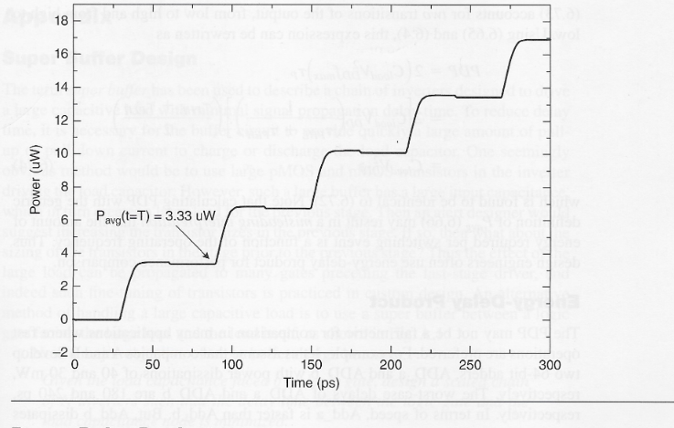

Slide 15
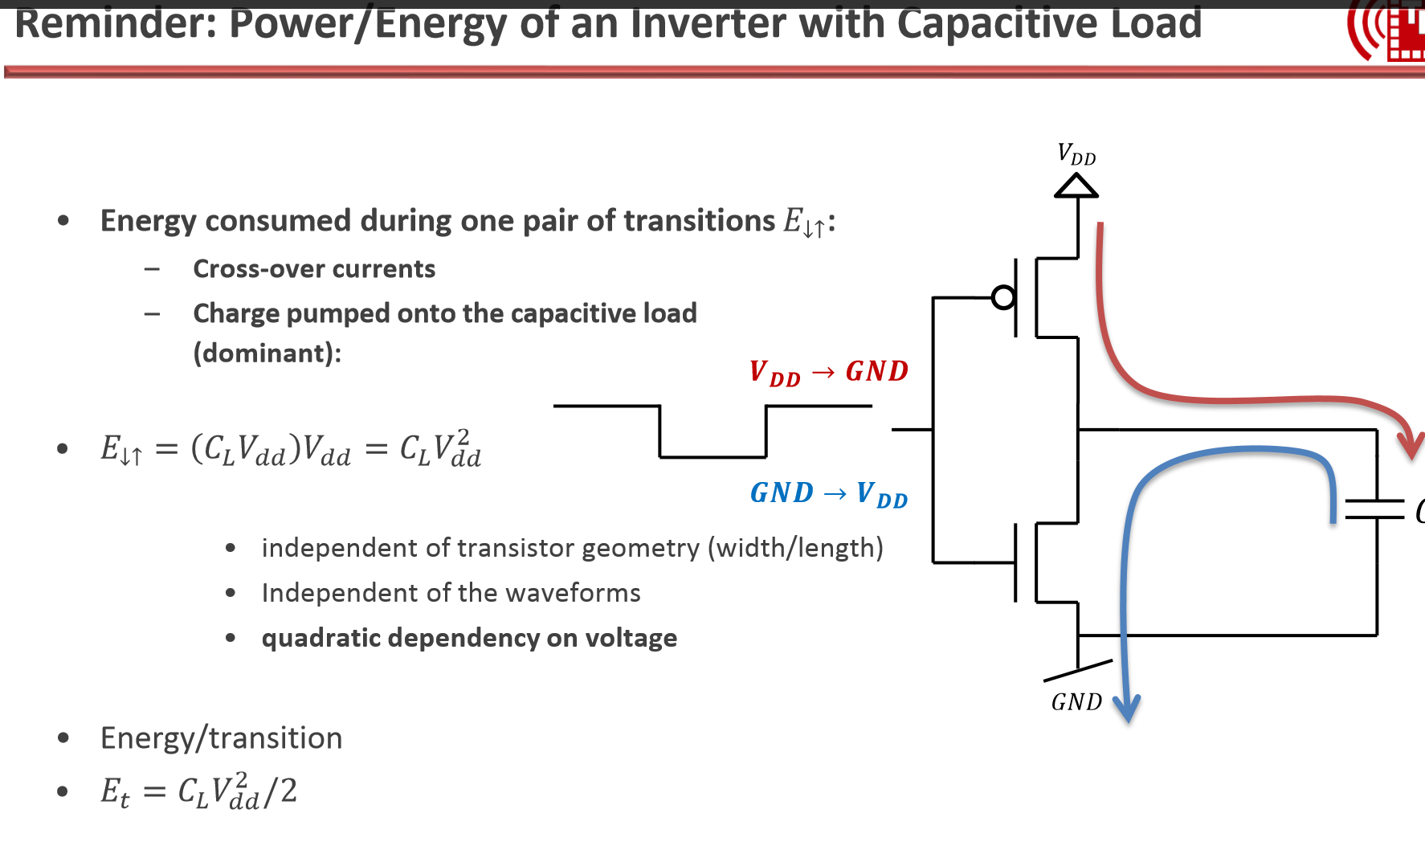

Slide 16
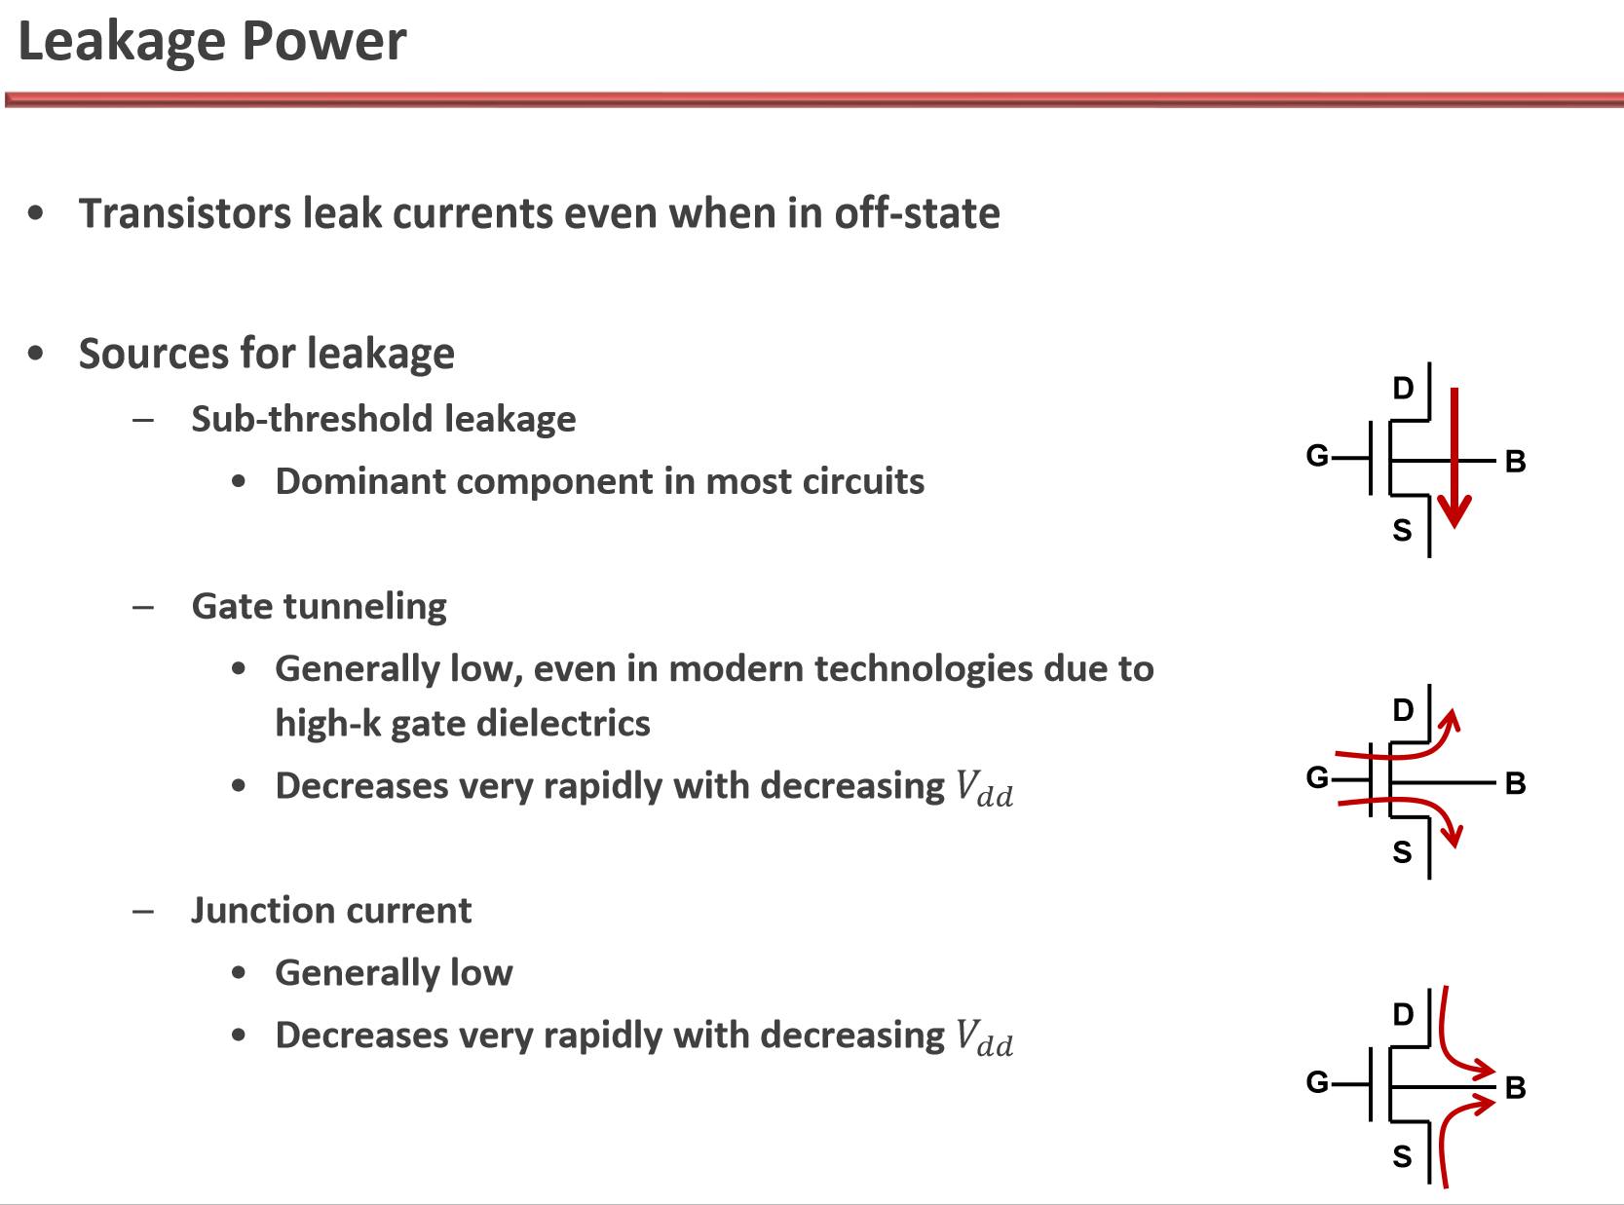

Slide 17
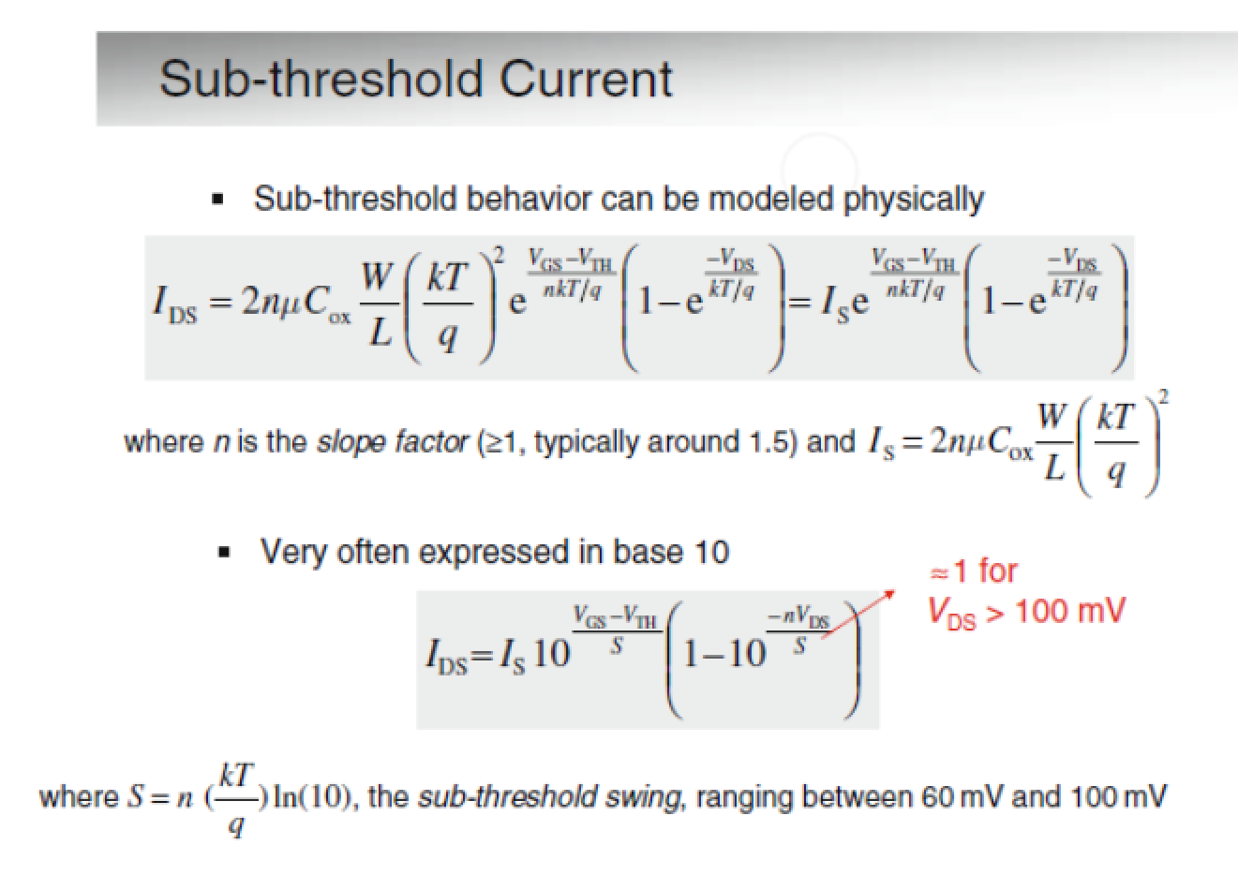
Subthreshold Current Equation

Slide 18
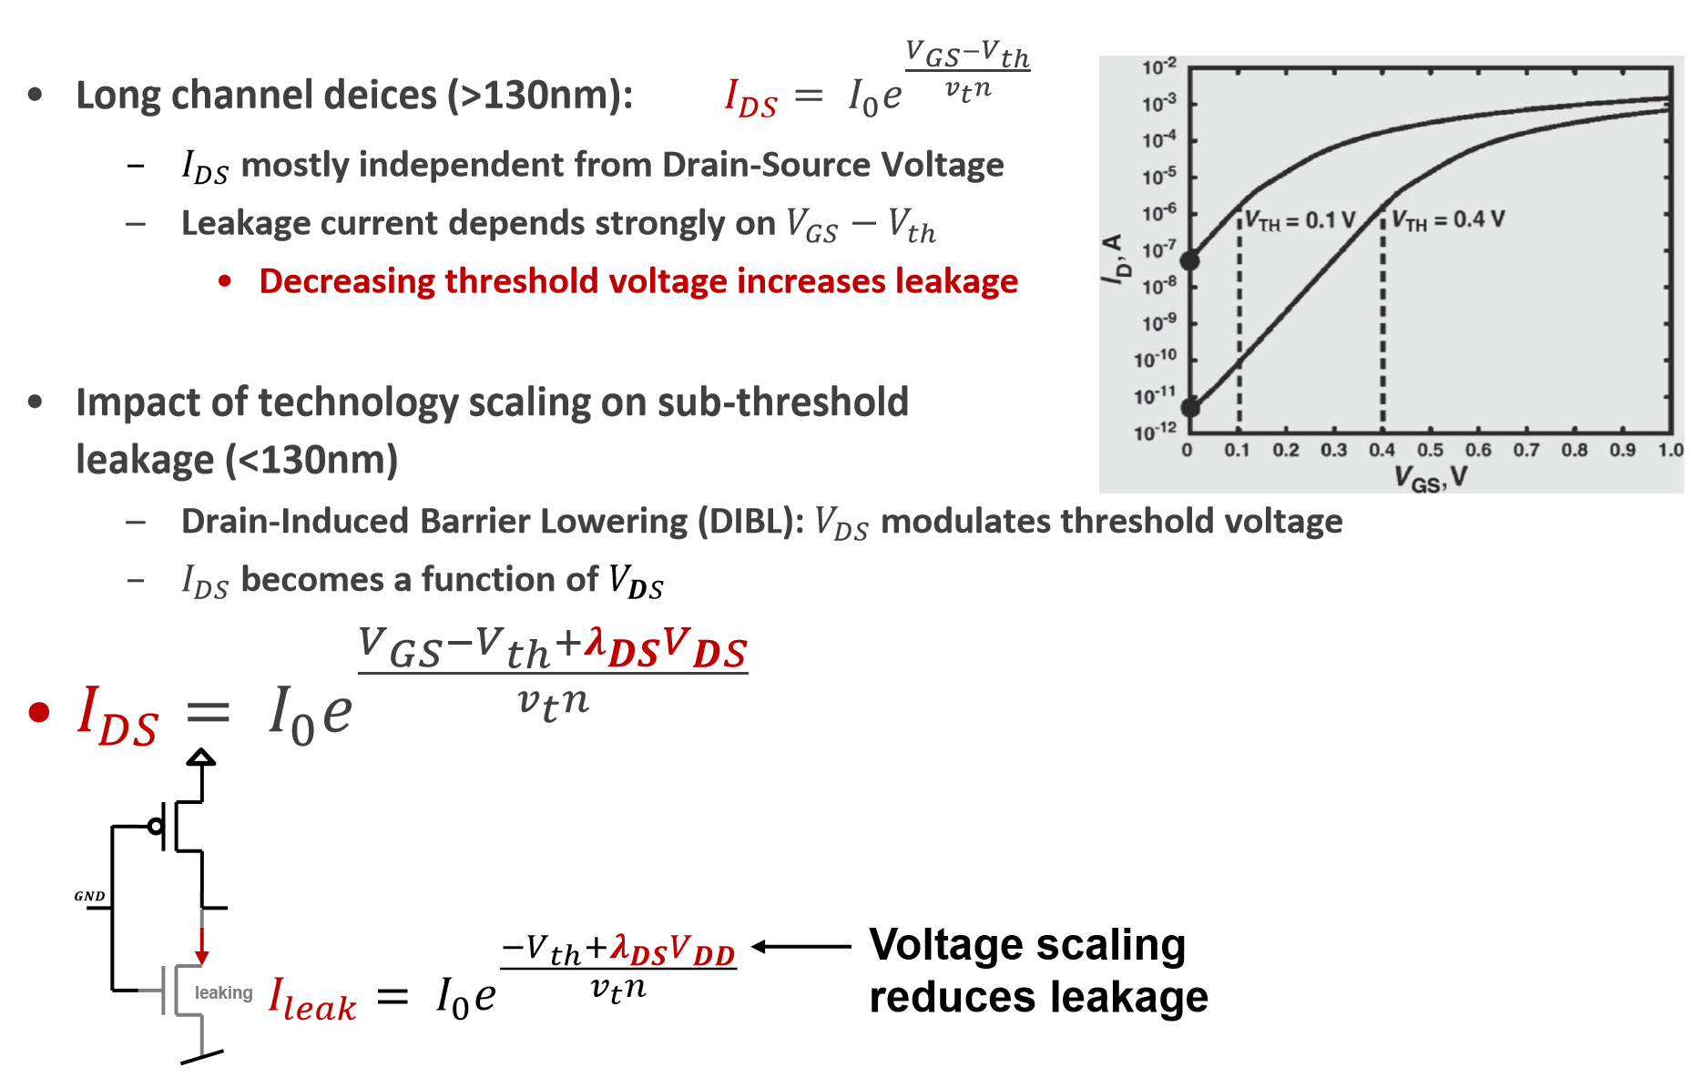
Leakage Power due to Leakage Currents

Slide 19
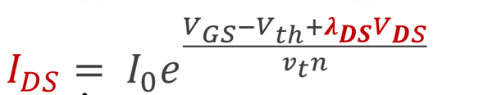

Leakage current
where $V_{t}$ = $\frac{KT}{q}$ = 26 mV at T= ${300 K}^{o}$

Slide 20
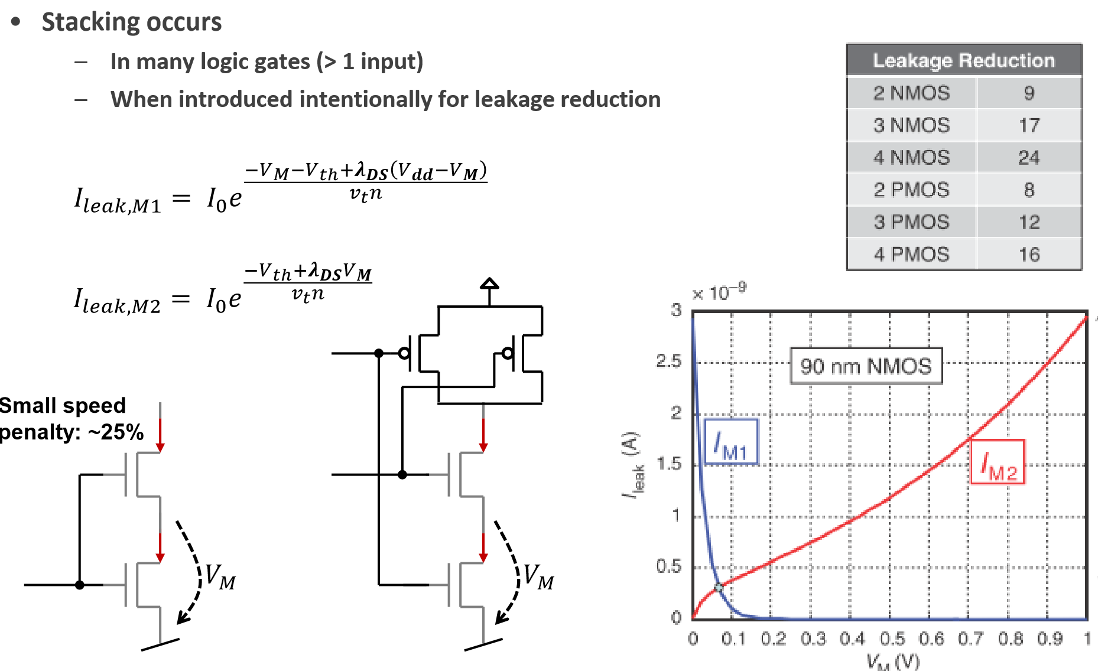
Leakage vs. MOST Stacking

Slide 21
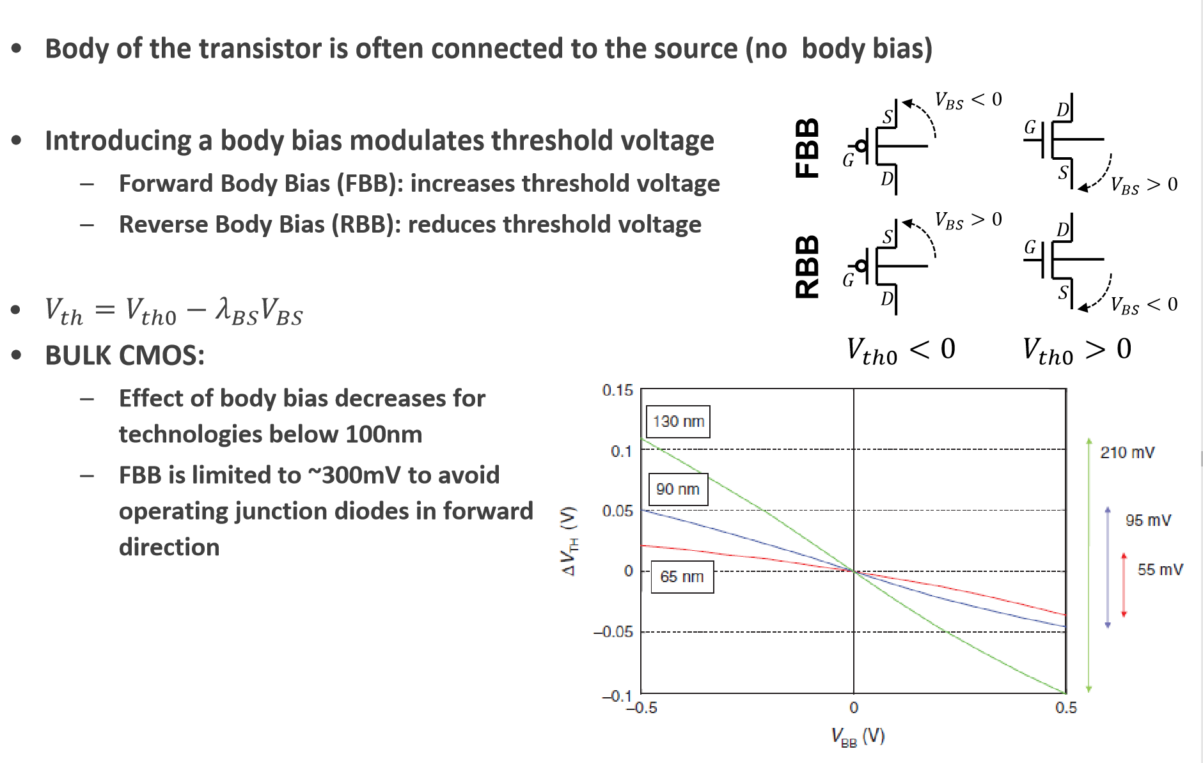
Body Biasing for VT Change

Slide 22
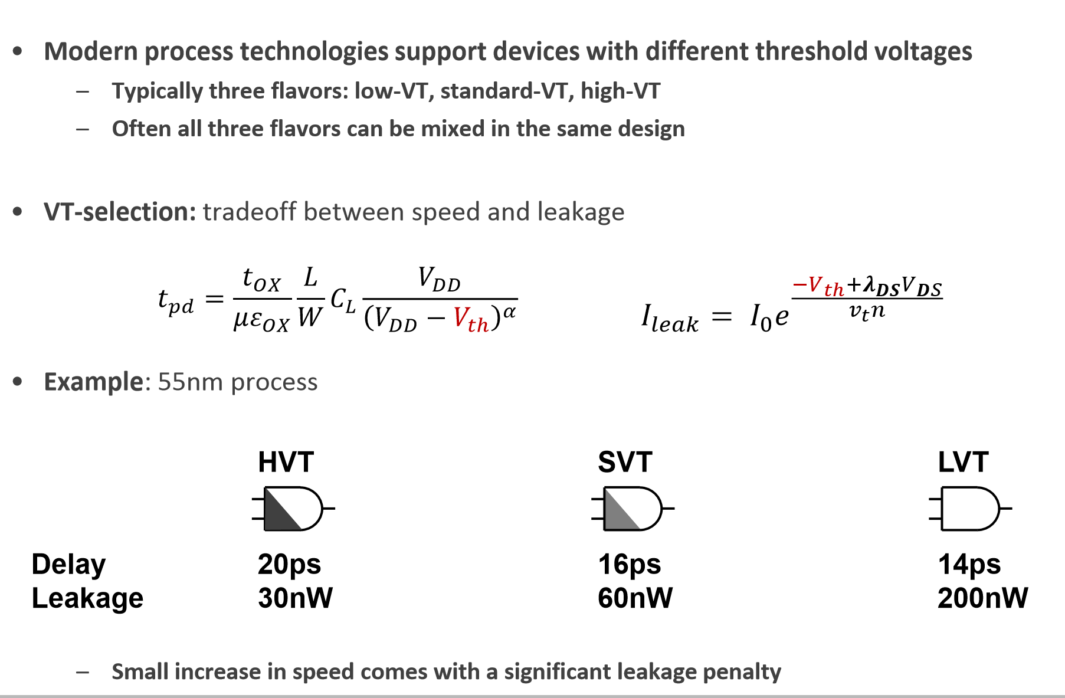
Threshold Voltages for HP, SP, LP

Slide 23
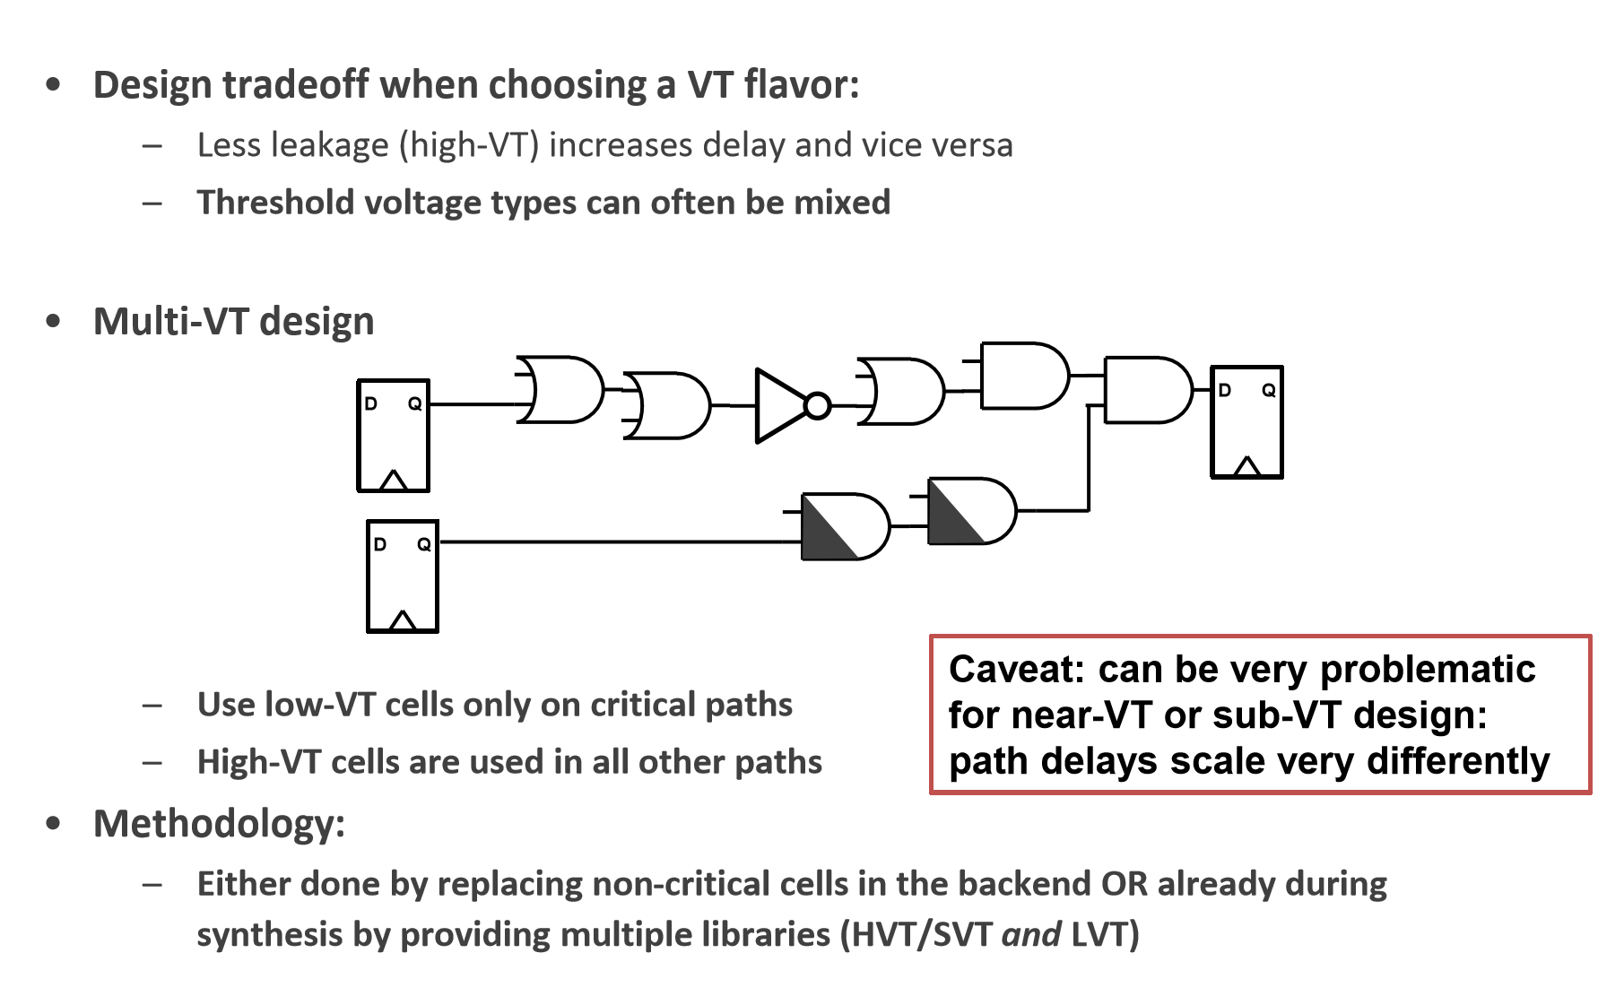
Multi-VT design

Slide 24
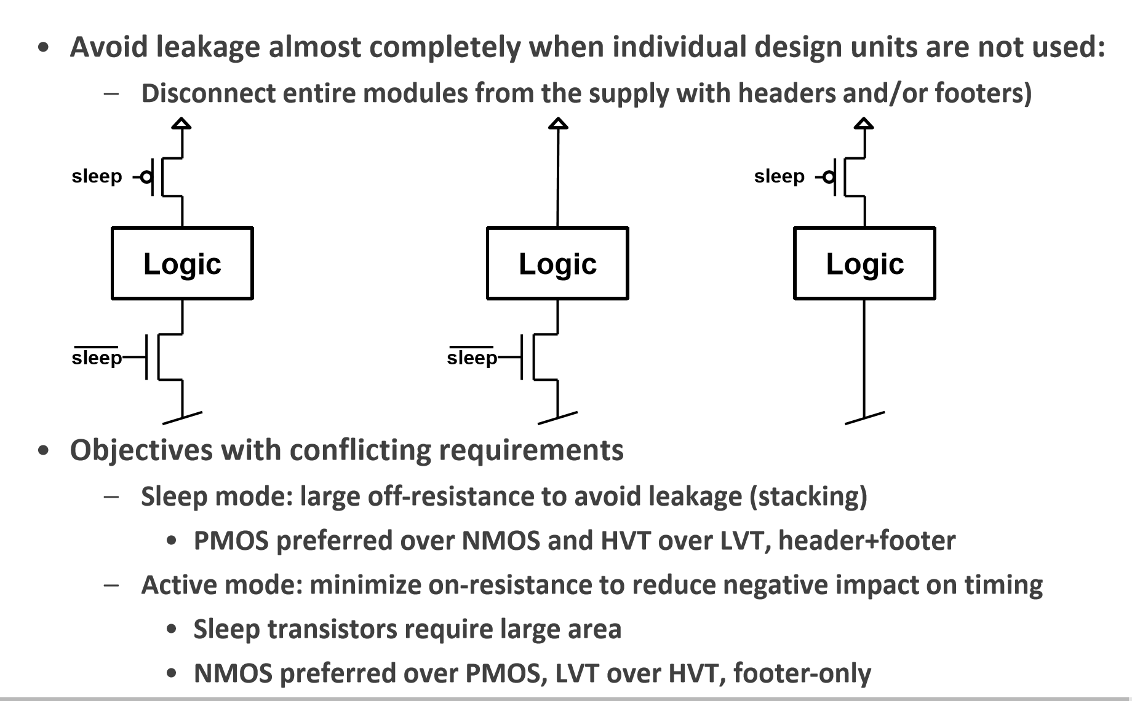
Power Gating to Turn Power Supply On & OFF

Slide 25
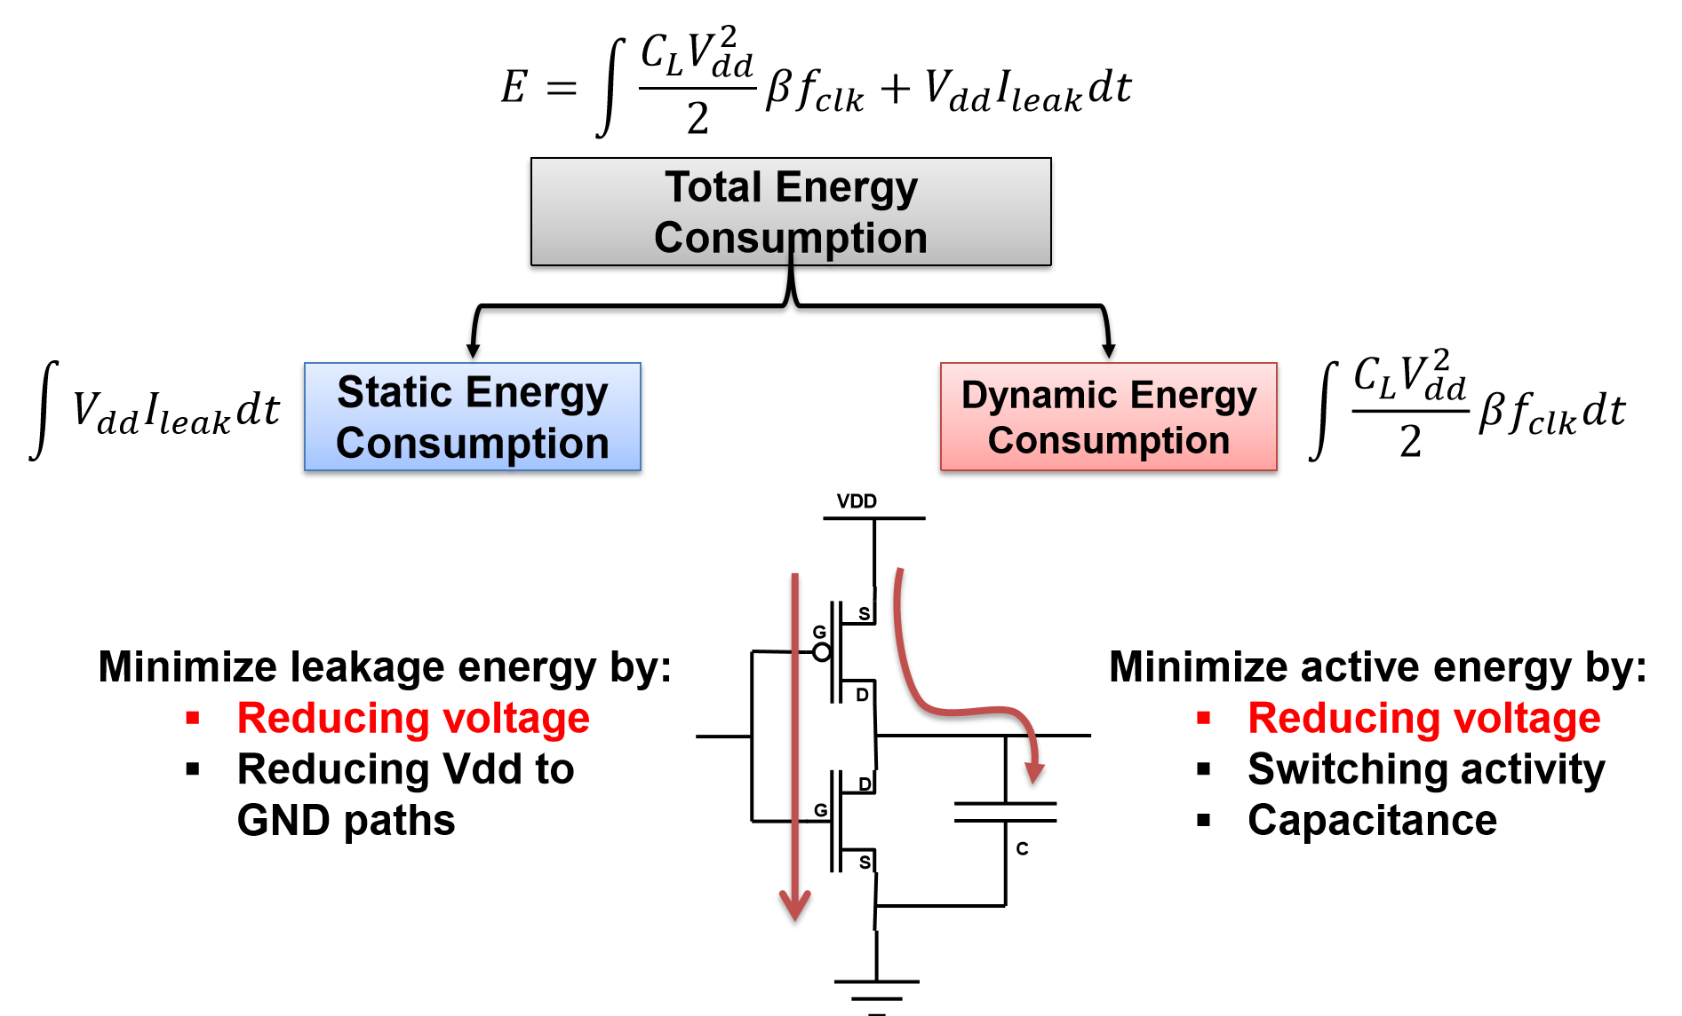
Voltage Scaling

Slide 26
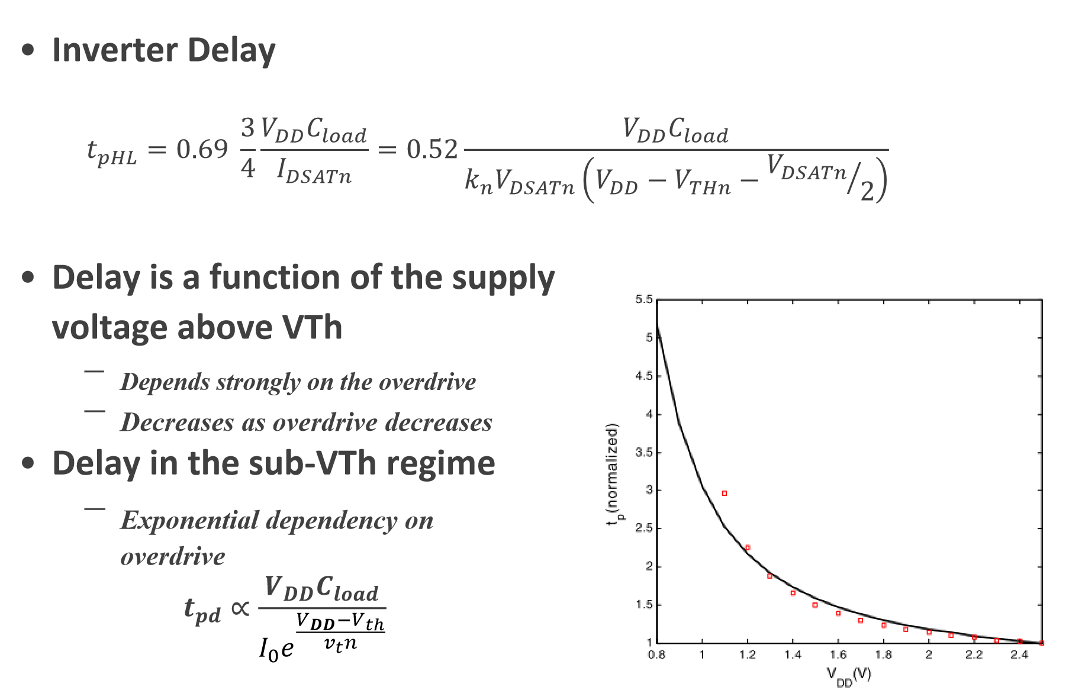
Voltage Scaling and Logic Delay

Slide 27
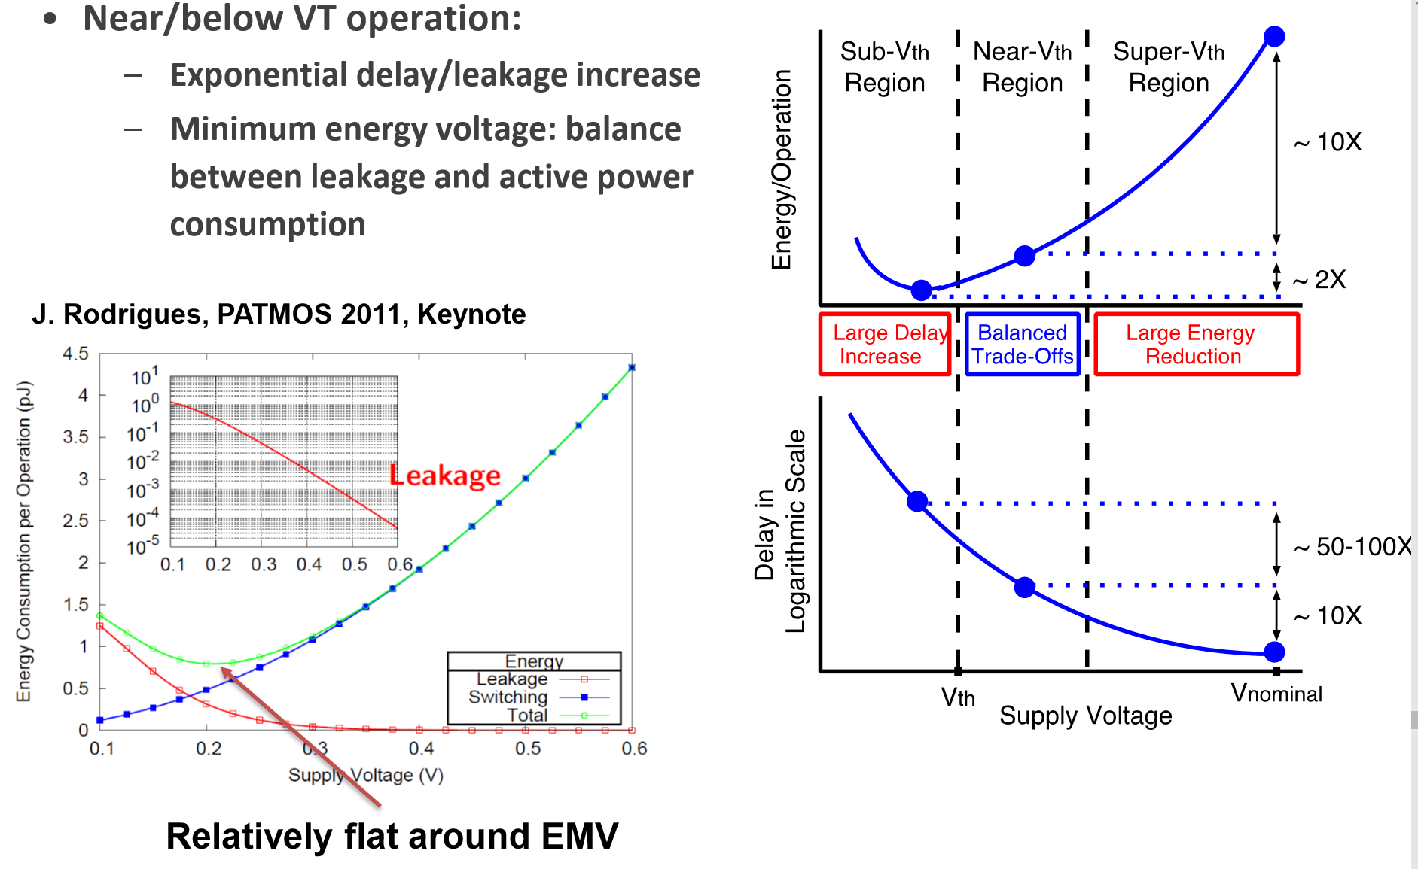
Ultra Low Power Design- Subthreshold Op.
EMV=Energy-minimum Voltage

Slide 28
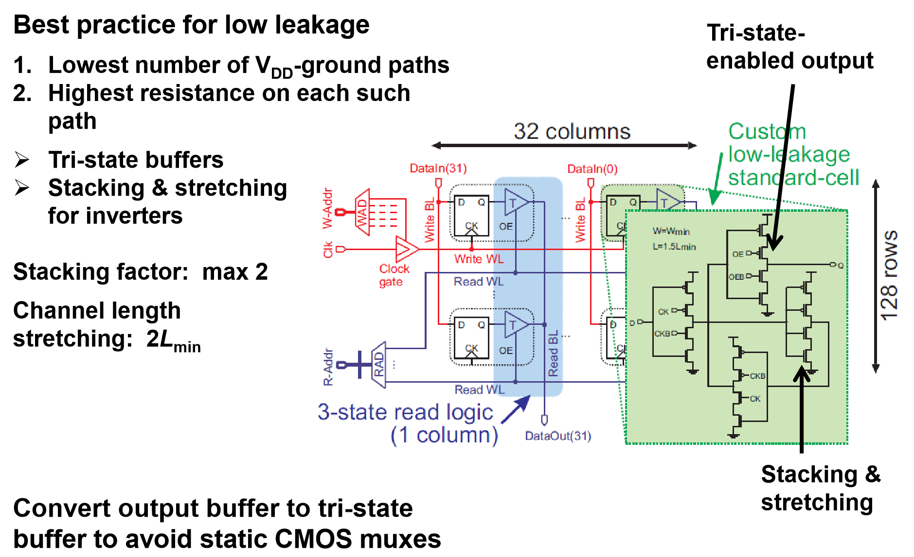
Low Leakage Latch with Tristate Buffer

Slide 29
Global Signaling Methodologies
Interconnect topology optimization
Circuit level interconnect design
Tree construction
Tapered buffers
Wire sizing
Repeater insertion
Wire spacing
Shield insertion
Wire shaping
Signal rerouting and wire reordering

Slide 30
Cascaded Buffers
⇒
Cascaded
buffers
C_{INT}
T_{PD} ∝ l
R_{INT}
T_{PD} ∝ l _{C} l _{R} = l ²
C_{INT}
R_{INT} and C_{INT} increase linearly with length
Assume R_{INT} = 100 Ω – fairly small if increase buffer size
R_{DSMIN} (W = .28 μm) = 2210 Ω
⇒ R_{DS} (W = 5.0 μm) = 118 Ω

Slide 33



Delay Dependence on Interconnect Length
  Repeater insertion commonly used to overcome this quadratic dependency

Slide 34
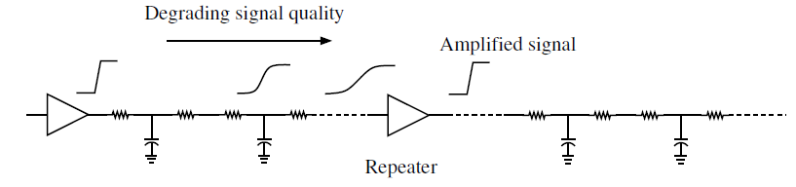
Repeater Insertion
  Delay reduced by dividing interconnect into smaller sections
  Repeater is inverting or non-inverting buffer placed at specific locations along interconnect
  Amplifying nature of inverters is exploited to restore signal

Slide 35
Repeaters
Large buffer with R_{DS} = 118 Ω cannot drive fairly small R_{INT} = 100 Ω
  R_{DS} (W = 10 μm) = 60 Ω
  Can drive R_{INT} but not efficiently
  Buffer overdrive problem — What about if R_{INT} = 200 Ω?
Partition line into multiple sections
  Make τ_{PD} ∝ l ² by inserting buffers or repeaters along the line ⇒ l
      R_{ON} = R_{DS} >> R_{INT} of each section of the line
1
2
3
4
k
k - number of sections
h - size of inverter

Slide 36
Repeaters
When interconnect resistance is comparable to or larger than the on-resistance of the driver, R_{INT} ≥ R_{ON}
where l is the interconnect length
Since both r_{INT} and c_{INT} increase linearly with length
By inserting localized buffers, such that R_{ON} >> R_{INT}
  t_{PD} is linear with length
R_{INT}
•
C_{INT}
1
2
3
4
k

Slide 37
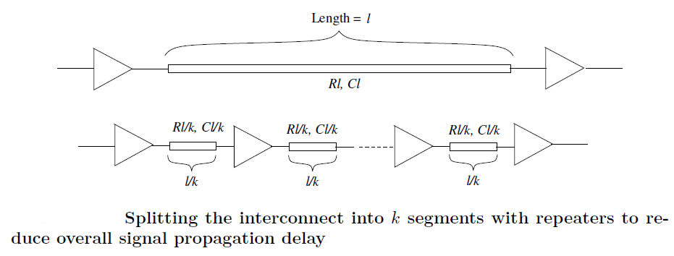

Reduction in Delay
  Original delay reduced by k
  Interconnect delay decreases with increasing k
  Additional repeaters increase gate delay
  What is optimum number of repeaters?

Slide 38
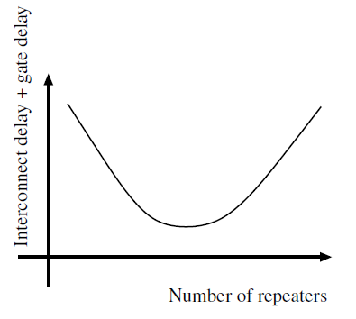
Delay versus Number of Repeaters
  Optimum number of repeaters that minimize overall delay
  Two parameters
    Number of repeaters k
    Uniform size h

Slide 39
Optimum Number and Size of Repeaters
  R_{o} and C_{o} are output resistance and input capacitance of minimum size inverter
  Inverter with size h, R_{o}/h
  Delay per stage
  Total delay = k x delay of single stage

Slide 40
Repeaters - Basic Design Expressions
R_{o} ~ on-resistance of buffer
C_{g} ~ gate capacitance of buffer
1
Segment delay (between repeaters) should be equal to repeater delay
  To achieve shortest delay
for k ≥ 2 and an integer
2

From buffer w/o repeater equation
T_{50%} = .4 R_{INT} C_{INT} + 0.7 (R_{tr} C_{INT} + R_{tr} C_{L} + R_{INT} C_{L})
Repeaters improve the delay of resistive lines since k ≥ 2, R_{INT} C_{INT} > 7 R_{o} C_{g}

Slide 41
Repeaters - Basic Design Expressions
Interconnect dominates for few stages
Repeater delay dominates with too many stages
Delay
- Minimizes size inverter
C_{L} = h C_{o}
Minimize size
gate capacitance
- Increases gain
Number of repeater stages
For k ≥ 2 and an integer
Segment delay (between repeaters) should be equal to the repeater delay
  To achieve the shortest delay
For uniformly sized repeaters
Time
Power
Size of repeaters

P_{DYN}
Number of repeaters
Number of repeaters

Slide 42
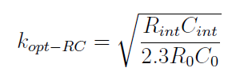

Optimum Number and Size of Repeaters
  Total delay = k x delay of single stage
  Take partial derivatives to find optimum h and k
  Optimum number of stages determined by ratio of interconnect delay to gate delay
    Higher ratio → k should be increased since gate delay is less significant
  Optimum size chosen to balance output resistance of repeater (R_{o}/h) and interconnect resistance (R_{int}/k)

Slide 43
Repeater Design Expressions - RC Line
1
2
3
4
k
RC line
Delay
Number of repeater stages

Slide 44
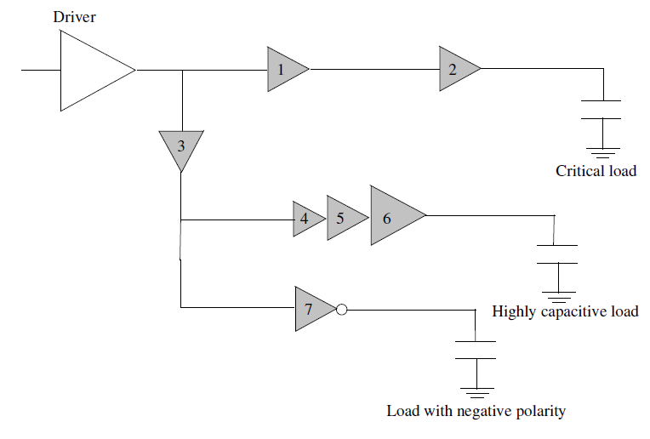
Repeater Insertion in Tree Structured Interconnects
  Buffered tree is important application of repeater insertion
  Four situations
    Split long interconnect to satisfy delay constraints (1 and 2)
    Isolate large capacitances from critical path (3)
    Drive large capacitances (4, 5, and 6)
    Reversing signal polarity (7)

Slide 45
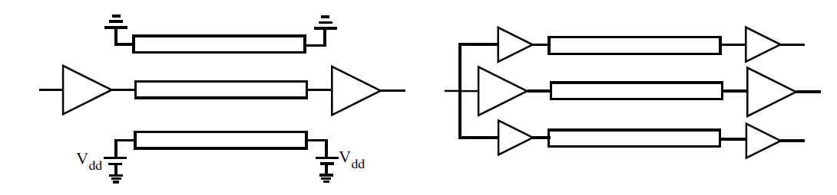
Shield Insertion
  Widely used technique where power or ground line placed between aggressor and victim to reduce coupling noise
    Passive shielding
  Active shielding
    Exploits miller effect
    Shield line switches in the same direction as the signal line
      Reducing effective coupling capacitance
  Both techniques consume additional area

Slide 46
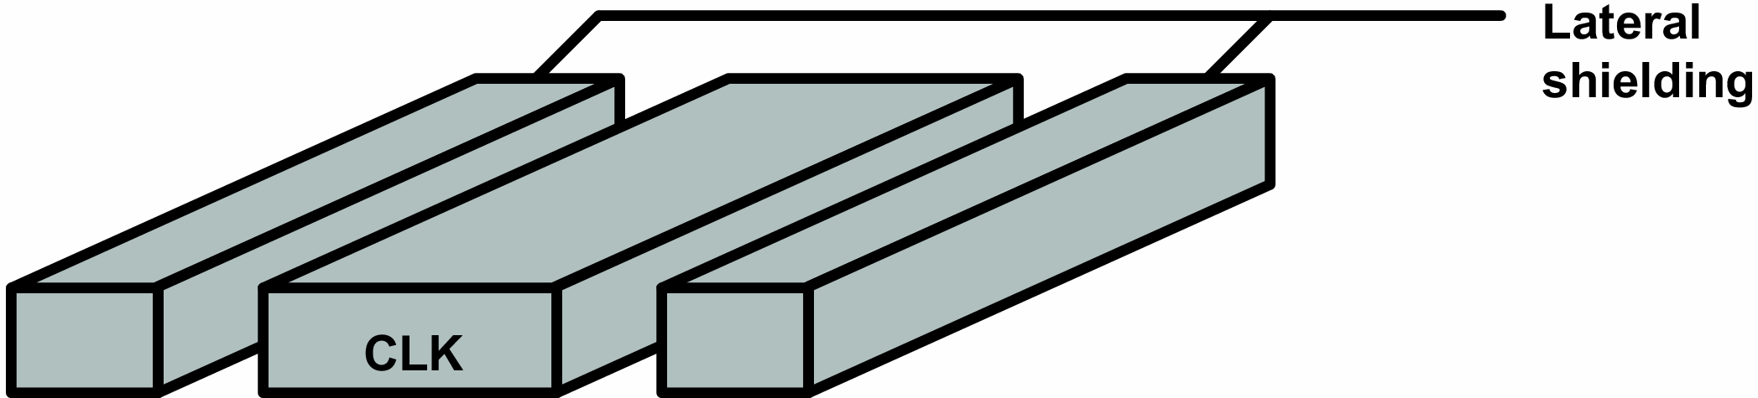
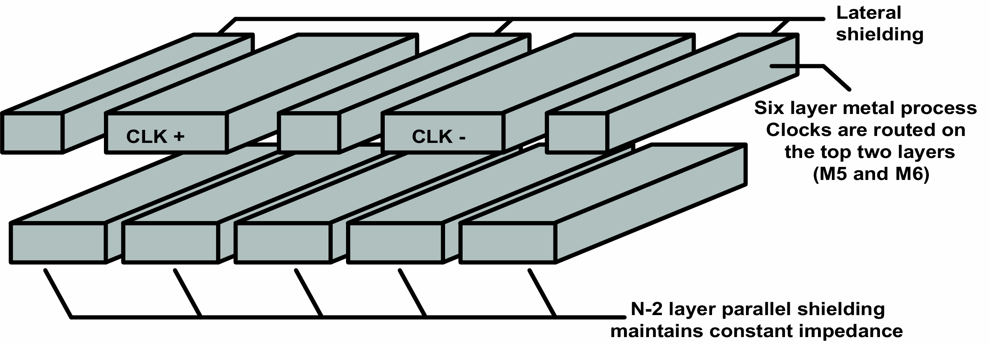
Passive Shielding
  Signal line isolated from the switching neighbor lines
    Reduced capacitive coupling noise
  Inductive coupling also reduced due to closer current return path
  Delay uncertainty reduced since effective capacitance is almost fixed
  Clock signals are typically shielded on both sides
  Additional parallel shielding on lower metal layer is possible

Slide 47
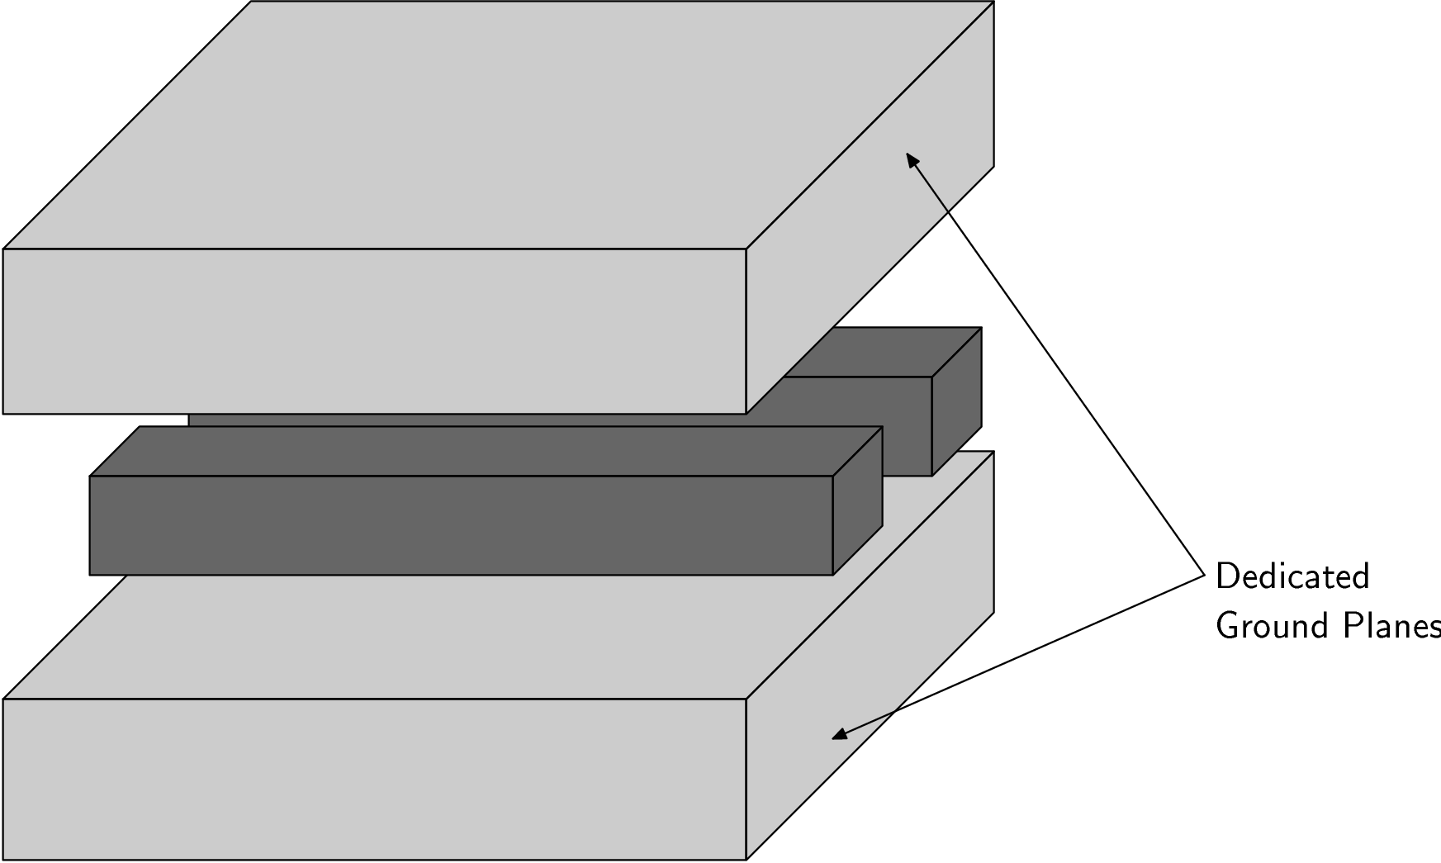
Ground Plane Shielding
  Entire metal plane is dedicated for shielding
  Not practical in modern resource limited ICs
  600 MHz Alpha processor
    Clock signal is shielded

Slide 48
Interdigitated Shielding
  Forms smaller current loop
  Smaller inductance and ringing behavior
  Tradeoff between inductance and capacitance/area
Clock
Interdigitate
Clock
Clock

Slide 49
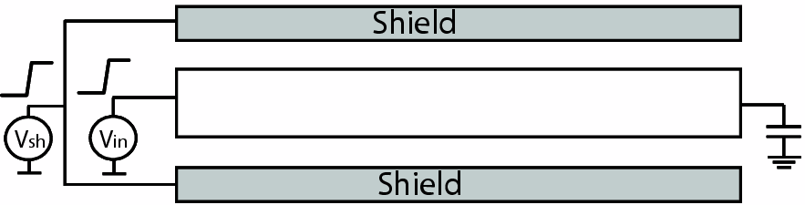
Active Shielding
  16% improvement in performance has been demonstrated
  Consumes more power due to additional switching activity of shield line
  Power due to coupling capacitance is reduced
  In-phase switching
    Active shielding for RC lines

Slide 50
Global Signaling Methodologies
Interconnect topology optimization
Circuit level interconnect design
Tree construction
Tapered buffers
Wire sizing
Repeater insertion
Wire spacing
Shield insertion
Wire shaping
Gate sizing
Signal rerouting and wire reordering

Slide 51
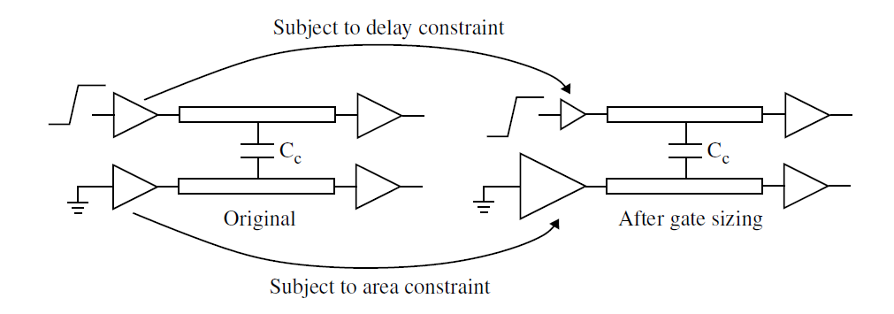
Gate Sizing
  Commonly used technique to exploit tradeoff between speed and power
    Gates along critical path sized up to satisfy delay
    Remaining gates sized smaller to reduce power dissipation
  Size of driver and victim also affects coupling noise and noise induced delay variation

Slide 52
Downsizing the Driver of the Aggressor
  Reduces capacitive coupling noise since driver is weaker
  Slows down signal path
  Tradeoff between delay and coupling noise
  Inductive coupling also reduced since less current is injected

Slide 53
Increasing the Size of Victim Driver
  Reduces both inductive and capacitive coupling since victim is more effectively connected to ground or Vdd
  Increases overall area
  Tradeoff between area and coupling noise

Slide 54
Global Signaling Methodologies
Interconnect topology optimization
Circuit level interconnect design
Tree construction
Tapered buffers
Wire sizing
Repeater insertion
Wire spacing
Shield insertion
Wire shaping
Gate sizing
Signal rerouting and wire reordering

Slide 55
Signal Rerouting
  Interconnect routing has been a focus for a long time
    Area, power, delay, and noise are all affected
  Target: Given connectivity information, minimize the wire length to achieve highest performance while reducing area and power
  Reconsidered to include crosstalk as a design constraint
    Spacing and length of overlap between aggressor and victim
  Two step routing process
    Global routing
    Detailed routing

Slide 56
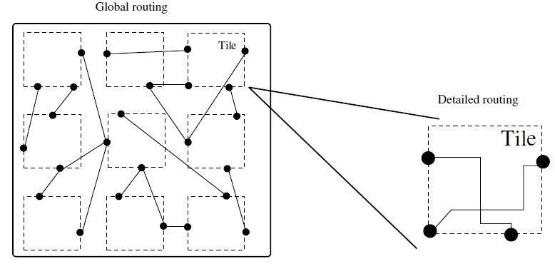
Global and Detailed Routing
  Overall area divided into tiles during global routing
  Path through tiles are determined for each net
  Routing of nets within the tiles achieved during detailed routing

Slide 57
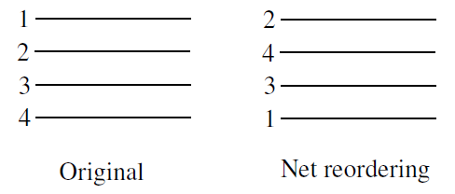
Net Reordering
  Order nets to ensure that sensitive nets are not placed adjacent to each other
  Assume
    1 and 2 are mutually sensitive
    2 and 3 are mutually sensitive
  Less efficient in reducing long range inductive coupling

Slide 58
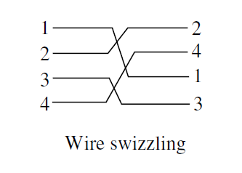
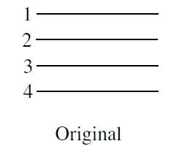
Wire Swizzling
  Wires split into several segments
  Wire sequences in each segment changed to ensure that capacitive coupling averages out for each wire
  Number of permutations required to realize all possible adjacencies is k/2
    For group of k wires
  For k = 4, need two permutations
    1234 and 2413

Slide 59
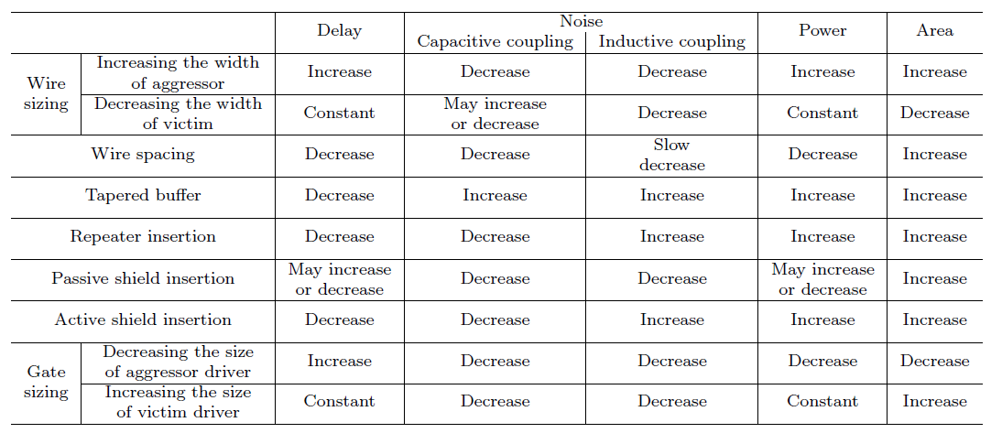
Power/Speed/Noise/Area Tradeoffs

Slide 60
Interconnect Centric Design
General Study of Interconnects
  Physical characteristics
  Modeling and extraction
Done !
Interconnect for data signals
Delay analysis
Crosstalk
Global signaling
Interconnect for power distribution
Power generation
On-chip power delivery
Low power design
Interconnect for clock distribution
Clock generation
Clock distribution
Timing optimization
Done !

Slide 61
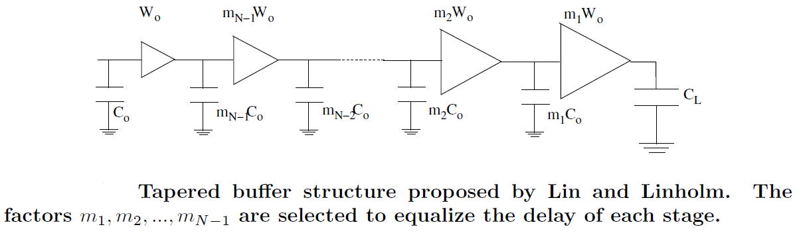

Overall Propagation Delay
  Assume C_{L}/C_{o} = M (load capacitance to interstage capacitance)
  Assume delay due to C_{o} is t_{po}
  Delay is assumed to be a linear function of the interstage and load capacitances

Slide 62

Find Minimum Propagation Delay
  What is the optimum scaling factor? m₁, m₂,…., m_{N-1}
  Differentiate total delay with respect to each factor
  Set each equation to zero

Slide 63
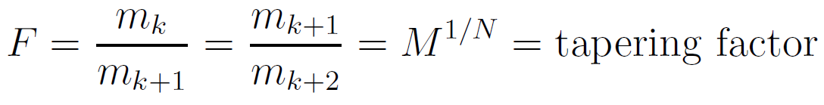


Find Minimum Propagation Delay
  Tapering factor (F) = ratio of the width of any two consecutive inverters
  Total propagation delay will be

Slide 64
Previously,

